Slide 1
ARA Digitalization - HS&E and Process Quality Enhancement through IIoT
Pintor Ortiz Walter Frank
Vijay Yadunund
ARTC
26 June 2019
3.0

Slide 2
Revision History
Version | Version Date | Section | Details of Revision
2.0 | 15/03/2019 | N.A. | Initial draft
3.0 | 25/06/2019 |  | Development

Slide 3
Contents
Project Definition
Problem Statement
Project Objectives
Technical Requirement
Project Management
Risks & Mitigations
RACI Chart
Stakeholders Map
Communication Plan
Project Plan
Work Breakdown Structure
Proposed Methodology
Project Schedule
Key Milestones
Project Deliverables
Miscellaneous
Questions about the project
Project Costs
Project Intellectual Property

Slide 4
Problem Statement
Currently at ARTC, there is no defined structure (both hardware and software) to obtain key information from robotic industrial environment where processes are executed (Robotic cells). There are efforts to retrieve information (such as joint values, robot position, etc.) from robot controllers, but a more flexible and industry-ready solution needs to be adopted (Creation/implementation of a platform). Insufficient information will lead to unsafe and uncertain scenarios in the future. Obtaining the right information will lead to solve current issues, such as:
Inexact utilization of power/resources (Robot operation, external actuators, lights)
Definition of dangerous environments for operators (Dust levels for instance)
Temperature changes (Process instability)
Environment vibrations
Notes:
Robotic environment data can be retrieved and published to cloud services to facilitate monitoring.

Slide 5
Project Objectives & Scope
This project aims at developing an IoT framework to understand robotic operating status, safety levels an other crucial robot information to enable digitalization capabilities.
In-Scope
Selection of IIoT solution
Sensors selection and integration in robotic cell
Sensors data streaming and monitoring
Data collected includes dust levels, humidity/temperature, noise levels and relevant variables for environment monitoring
Robots data streaming and monitoring
Data collected includes robots pose frame, joint values, robot state and select IO signals only
Robot Data streaming using TCP/IP protocol
Out of Scope
Application support for brands other than ABB
Visualization/Simulation of robots
Encryption of data accessed
Benchmarking of calibration results against similar applications
Commercialization

Slide 6
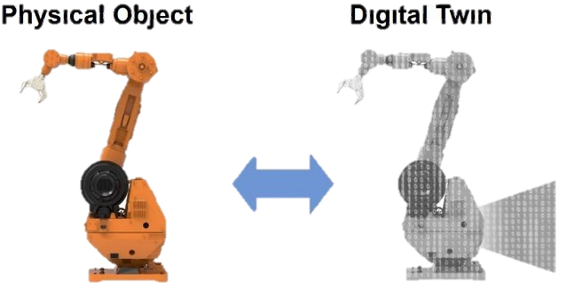

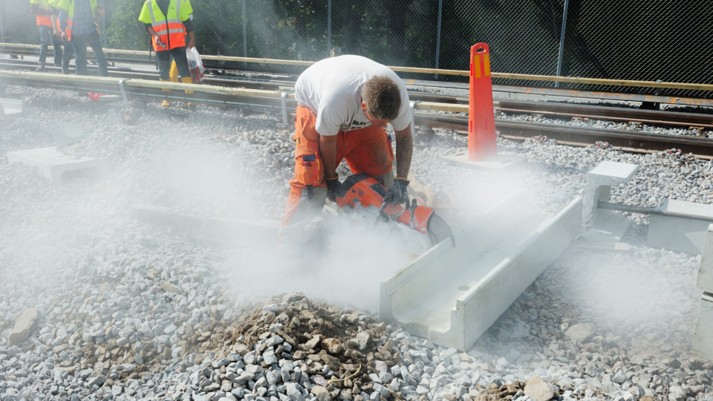

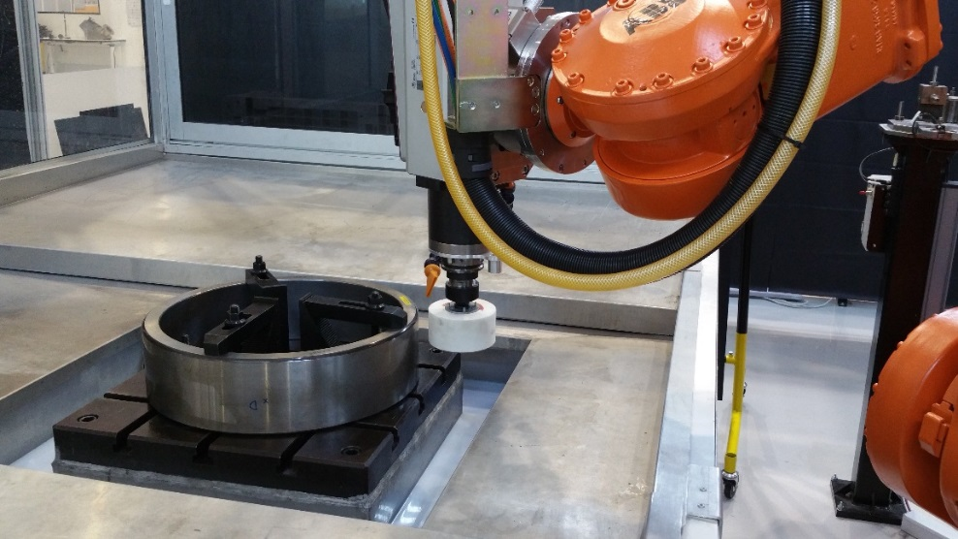
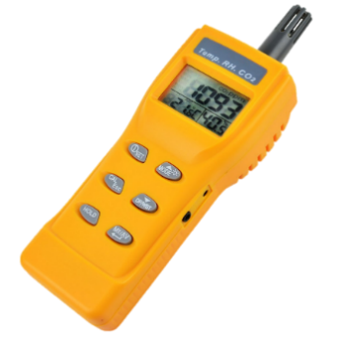
Technical Requirement
Robotic industrial setups are lacking key information.
Process set-up – Process information and environmental effects on process
Information of physical devices to generate digital twins
Optimization of processes by monitoring and standardization (humidity/temp)
HS&E – Optimal conditions (environment) for humans to interact
Energy consumption – Extended hours of utilization
Notes:
https://sg.element14.com/sharp/gp2y1010au0f/sensor-dust-optical/dp/9707956?gclid=Cj0KCQjws5HlBRDIARIsAOomqA2EnFvCT2uMoDfKBz0SxB2m9h0-YPvDkxKXRRPkkt4y32VpwxpocRAaAiddEALw_wcB&gross_price=true&mckv=sdPSduIJG_dc|pcrid|155925702681|pkw||pmt||slid||product|9707956|pgrid|34507690943|ptaid|pla-41477300408|&CAWELAID=120185760001223203&CAGPSPN=pla&CAAGID=34507690943&CMP=KNC-GOO-SHOPPING-9707956&CATCI=pla-41477300408

Slide 7
Proposed Methodology
Data extraction
Connectivity
Data streaming
Objectives: Collect all data and information, from both robot controller and industrial robotic environment.
Scope:
(1) Sensor selection
(2) Sensor integration and strategic placement
Methodology:
(1) Design conceptualization and selection
(2) Sensor knowledge and characterization
Objectives:
Low level sensors and robot controllers pass information to the industrial PC
Scope:
(1) Robot controller software for data collection – TCP/IP
(2) Robotic environment data collection - UART
(3) Robot controller software for data streaming – TCP/IP
Methodology:
(1) Develop software modules for TCP/IP communication
(2) Test and debug software
Objectives:
Bridge the existing gaps between IPCs and Clouds to ensure the correct flow of data.
Scope:
(1) Local server to collect robot controller data
(2) OPC-UA integration between IPC, Gateway and Cloud
(2) Data visualization through tools like tableu
Methodology:
(1) Develop software modules for OPC-UA communication
(2) Develop Graphical User Interfaces for data visualization
(2) Test and debug software

Slide 8

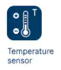

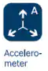
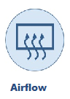
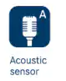
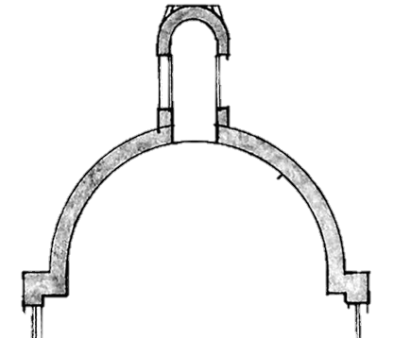
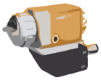
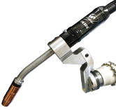




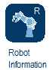
Proposed Methodology
Integration of IIoT concepts:
Sensor selection and integration to IPC
Data extraction and collection / Data streaming to cloud services
Data visualization / Dedicated dashboard
Development of software applications for robot data retrieval with GUI to:
Connectivity between robot controllers and PC application. The system will be able to:
Read robot pose frames, joint values, robot state and select IO signals
Define format for packing data prior to publishing. The same format to be used for unpacking at destination
Publish data to remote server via TCP/IP connection
To Cloud
Gateway / Ex. Mindconnect nano
OPC-UA
UART/An In
IPC
UART/An In
TCP/IP
* Example of environment monitoring and process control.
ABB IRB
ABB IRC5 (1)
ABB IRC5 (2)
ABB IRB

Slide 9
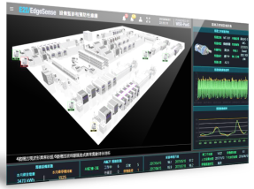




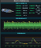
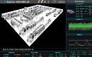

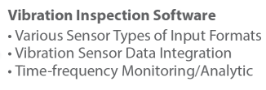

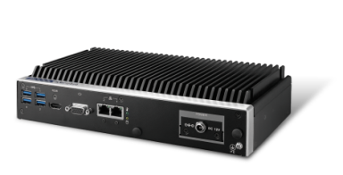
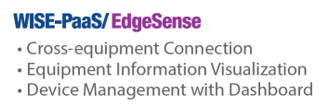
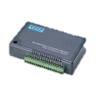
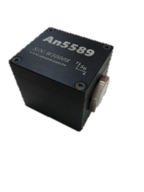
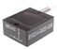
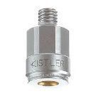
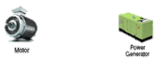
Proposed Methodology
Cloud Management
EVM Insight Dashboard
Cloud Integration
Edge Intelligence
EIS
EIS
Field Site
USB-4704
3rd party
Sensor
Sensor
Target area
*Example of system diagram – Courtesy of Advantech

Slide 10
Work Breakdown Structure
Digitalization for ARA team (IIoT) – HS&E and Process Quality Enhancement through IIoT
Data extraction
Connectivity
Report
IPC to Gateway connectivity
Project updates
Robotic Environment – Data extraction
Robot Controller -Data extraction
Gateway to Cloud connectivity
Lessons learnt
Sensor selection
System architecture, GUI design, application wireframes
Read/Write RAPID data
Data streaming
Report writing
Sensor Integration
Format Data packaging
Dashboard and data visualization development
Network Scanner to scan and connect to robot controllers in the network
Sensor Characterization
Publish packaged data
Performance evaluation

Slide 11
Project Schedule
 |  | May |  |  |  |  | June |  |  |  | July |  |  |  |  | August
 |  | W1 | W2 | W3 | W4 | W5 | W1 | W2 | W3 | W4 | W1 | W2 | W3 | W4 | W5 | W1 | W2 | W3 | W4
Project initiation | PA and documentation
 | Design and initial concept |  |  |  |  |  |  |  |  |  |  |  |  |  |  |  |  |  |  |  | Planned
 | RA |  |  |  |  |  |  |  |  |  |  |  |  |  |  |  |  |  |  |  | On execution
 | Kick-off session |  | M0
Data Extraction - Robotic environment | Sensor Selection (Procument included)
 | Sensor Integration
 | Sensor Characterization |  |  |  |  |  | M1
Data Extraction - Robot controller | Development of functions to access controller
 | Network Scanner - ABB Robots
 | Read/Write RAPID
 | Communication (Data format and publishing of data)
 | GUI design
 | Evaluation, debugging and testing |  |  |  |  |  |  |  |  |  | M2
Connectivity | IPC to Gateway connectivity
 | Gateway to Cloud connectivity
 | Dashboard and data visualization |  |  |  |  |  |  |  |  |  |  |  |  |  |  | M3
Final Report | Report preparation
 | Report review (ARTC)
 | Report release |  |  |  |  |  |  |  |  |  |  |  |  |  |  |  |  |  | M4

Slide 12
Key Milestones
Project start – May 2019
M1: Sensors integration / Environment – June 2019
M2: Evaluation, debugging and testing / Robot – July 2019
M3: Dashboard and data visualization – August 2019
M4: Report – August 2019

Slide 13
Project Deliverables
Hardware environment
Sensors to identify physical environments in the network
Hardware Integration
Software executables for
Data Streaming
IPCs and Gateway connectivity
Dashboard
A report that covers the following:
Software architecture
Hardware structure
Development methodology
Results

Slide 14
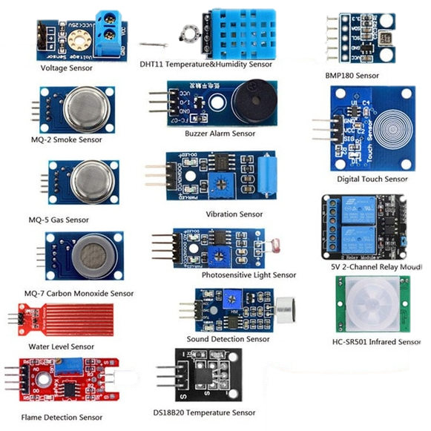
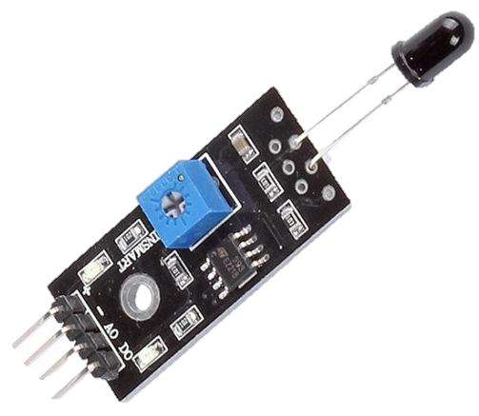
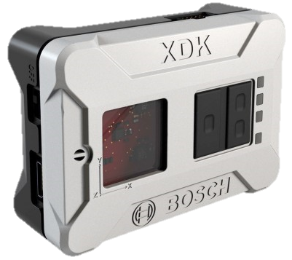
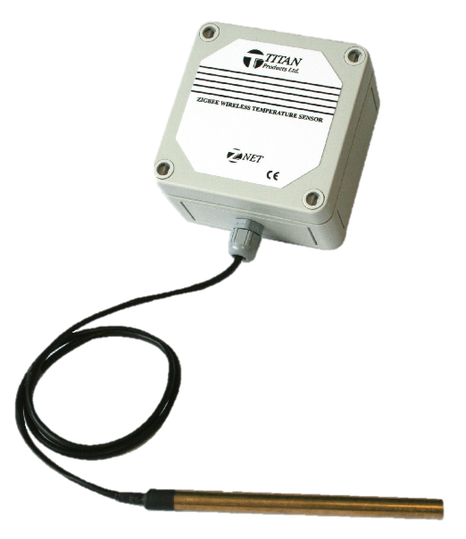
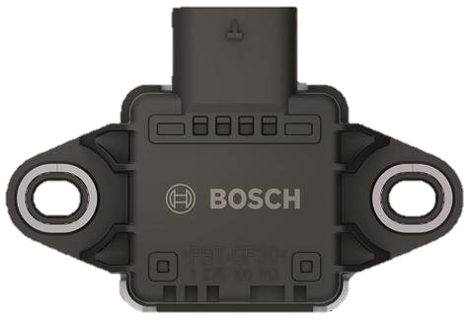
Hardware Environment
Sensors to identify physical environments (Still being selected)
Example – SaintSmart flame detection sensor
XDK – 8 Sensors in 1
Immersion temperature reader
CISS – Bosch Sensors

Slide 15
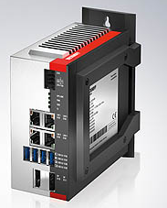
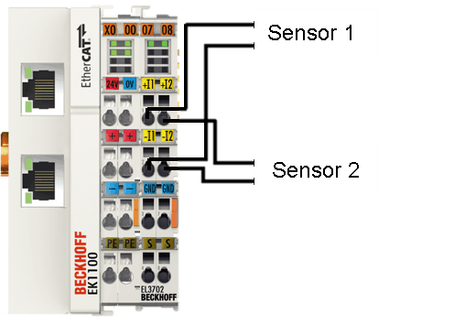
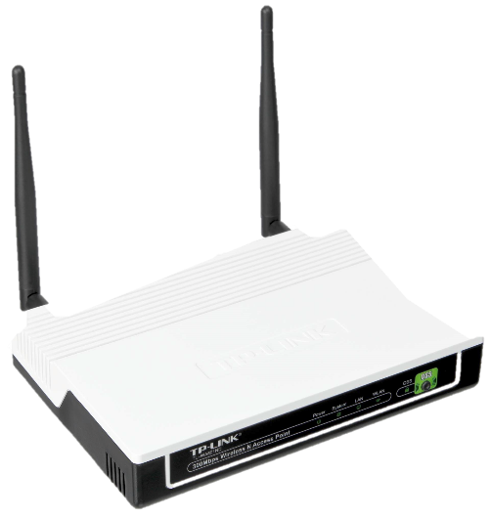
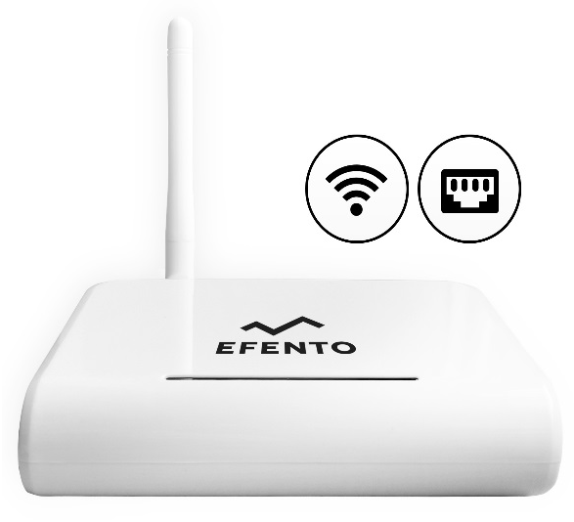
Hardware Environment
Other hardware (Acquired)
Industrial PC - Edge
IO acquisition cards – AIO (4-20mA – 0-5v – 0-10v) / DIO
Routers

Slide 16

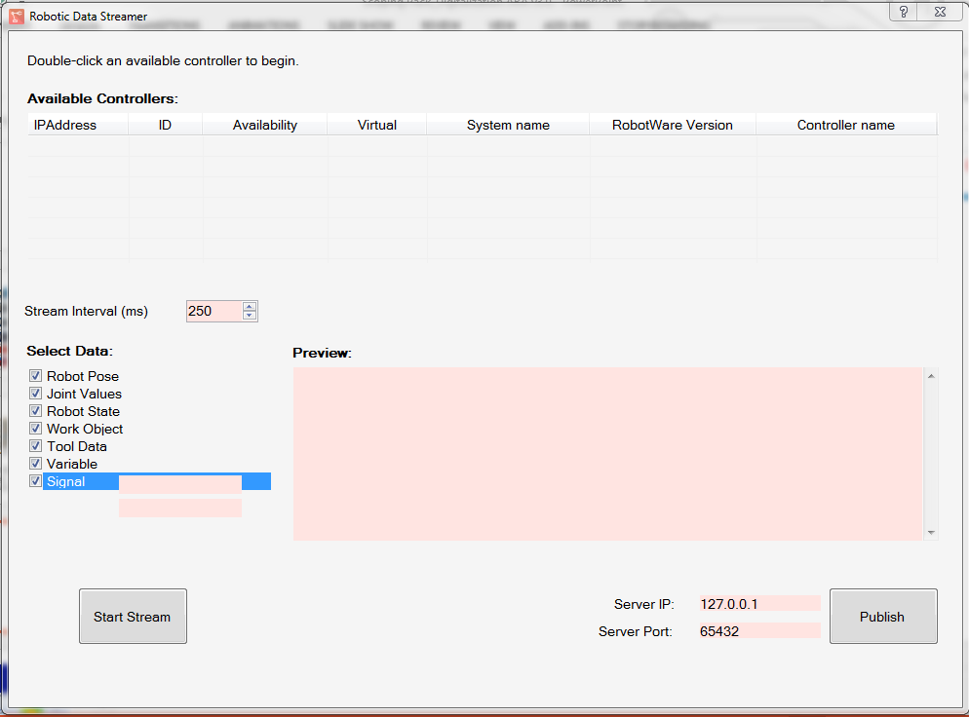
Software
Data streaming for ABB robot controller
1
2
3
Controllers in network
Options to read
Data displayed
Server information to be published using the standard TCP/IP protocol
4
C#

Slide 17
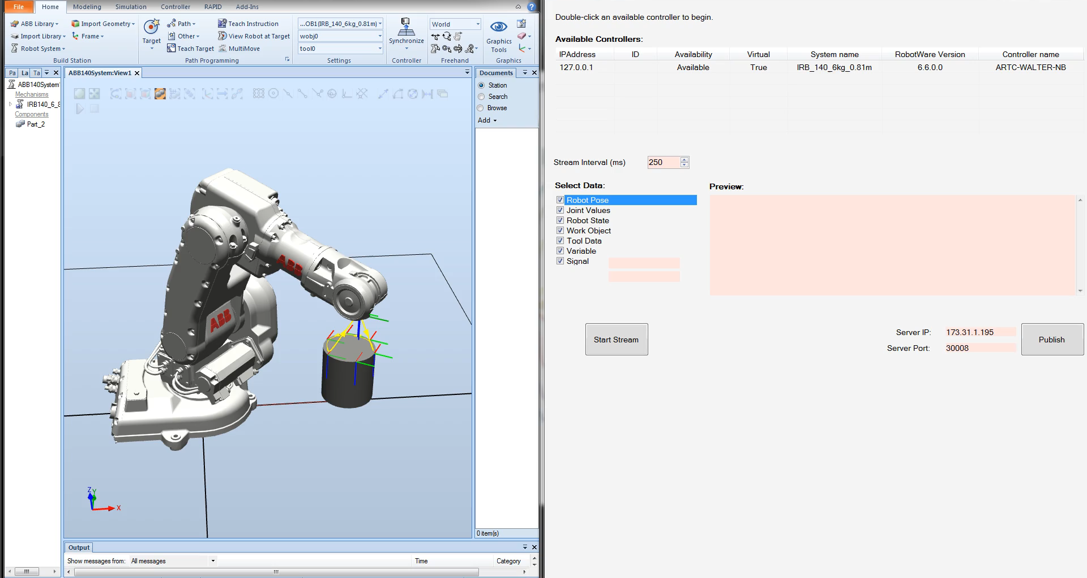
Software
Example of operation for Robotic Data Streamer

Slide 18
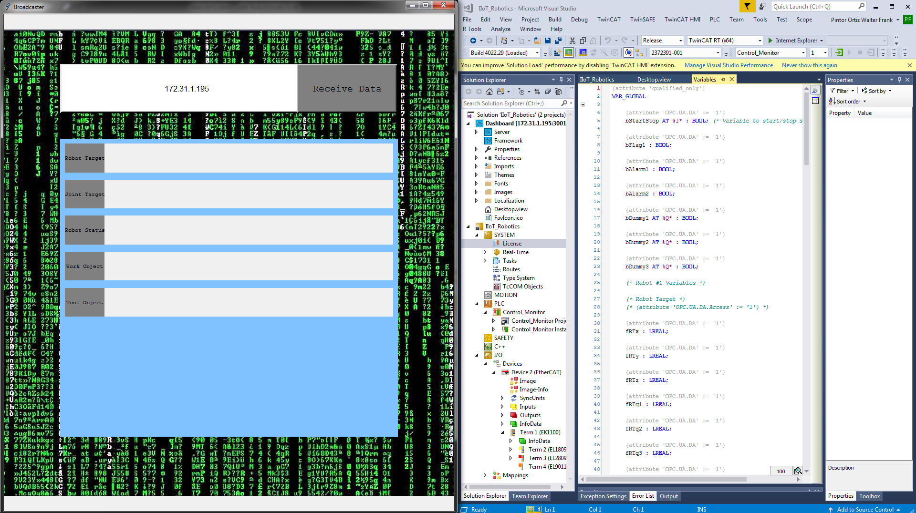
Software
IIoT_Robotics and Robot_broadcaster
1
3
2
TCP/IP server IP address
Displaying boxes for data received from TCP/IP client
Variables declaration for IPC (OPC-UA server)

Slide 19
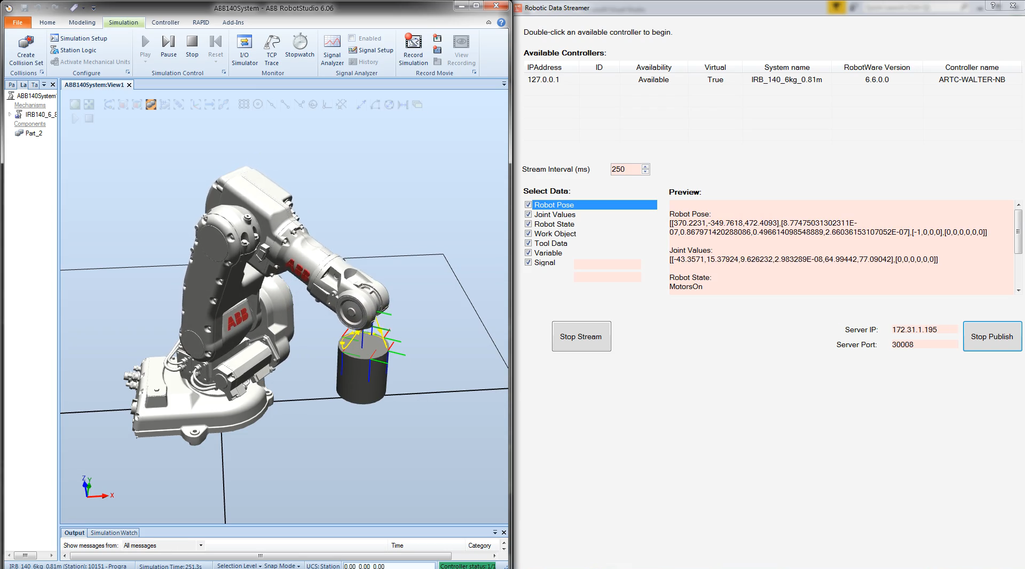
Software
Example of operation for IIoT_Robotics and Robot_broadcaster
Python
Structured Text => PLC

Slide 20
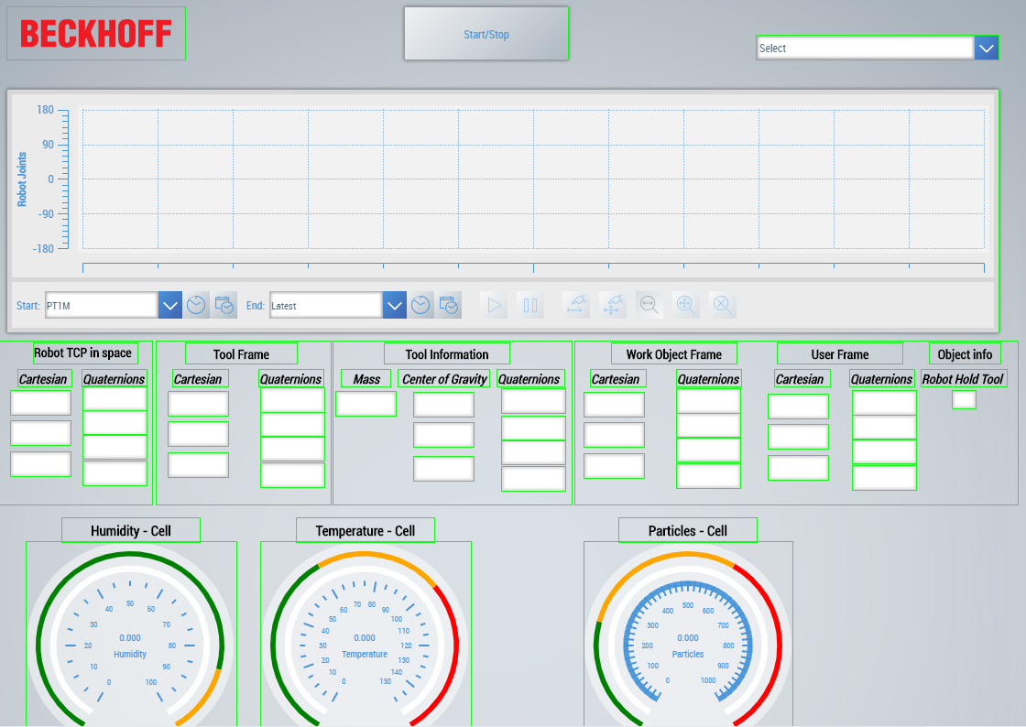
Software
Dashboard concept
1
Robot Joint chart
Robot data
Gauges for general information about working cell – To be increased
2
3

Slide 21
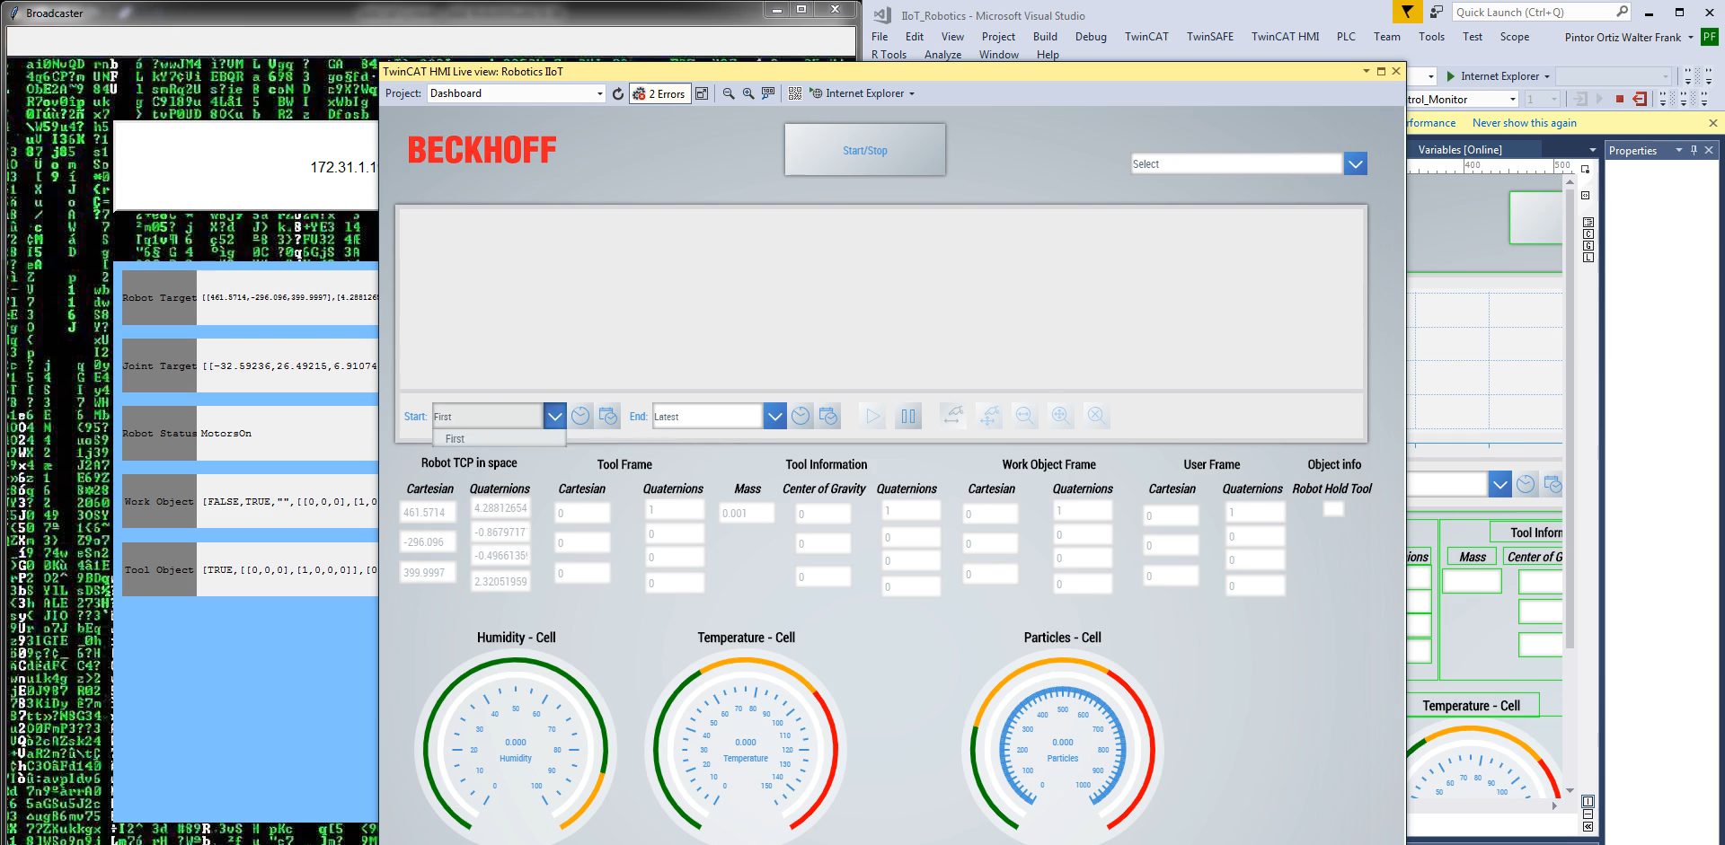
Software
Dashboard

Slide 22
Next steps
Hardware
Finalize procurement of sensors
Integration
Integrate/connect robot controller(s) in same network
Software
Characterization of sensors
Ensure initialization of robot streamer connects to all robots in network
Connection of multiple robots in robot streamer
Stream quantity of ABB robots connected
Robot_broadcaster to receive and publish more information
Investigate if OPC-UA server can autonomously generate new variables for robots and sensors
If not possible, define the bandwidth for operation in ARTC

Slide 23
High Level Risks & Mitigations
ID | Risk Description | Initial Risk |  |  | Mitigation Plan | Mitigated Risk |  |  | Owner
 |  | Likelihood | Impact | Risk Level |  | Likelihood | Impact | Risk Level
1 | Connectivity issues among nodes and gateway | 3 | 4 | 12 | Utilize initially simple protocols of communication to demonstrate IoT | 2 | 4 | 8 | Walter
2 | Connectivity issues between digital suite and server | 3 | 2 | 6 | Utilize same host machine | 3 | 2 | 6 | Yadunund
3 | Limitations of sensors to detect physical variations | 1 | 5 | 5 | Identify zones of risks Utilize more sensitive sensors | 1 | 4 | 4 | Walter

Slide 24
RACI Chart
 | Project Management | Project Team Members
 | Project Manager | Vijay Yadunund | Pintor Ortiz Walter Frank
Project Capture
Receipt of SoW/SoR |  | A | R
Project Charter Preparation and Approval |  | A | R
Project Initiation
Scoping pack, Cost Sheet and Project Agreement preparation |  | A | R
Project Execution
Software Architecture and application wireframes |  | R | R
Network scanning and connectivity framework |  | R | C
Passive data access module |  | R | C
Data packing format |  | C | R
Plane fitting algorithm |  | R | C
Sphere fitting algorithm |  | C | R
Laser scanner integration |  | R | C
Software integration |  | R | C
Testing |  | R | R
Project Closure
Final Report |  | R | C
Project Closure meeting |  | R | R

Slide 25

Stakeholders Map (Projects w/o RI/IHL and Customers )
ARTC
David Low (Chief Executive Officer)
Nicholas Yeo (Technical Director)
Chia Kiang Sum (PMO Director)
Escalation Path
ARTC
Tijo Thayil (Group Manager)
ARTC
<Name> (Project Manager)
Pintor Ortiz Walter Frank(Technical Leader)
Vijay Yadunund (Team Member)

Slide 26
Communication Plan
Kick-off Meeting
Involving all Project Members and Stakeholders after the project is approved and bought-off
Weekly Team Meetings
Discussions on project updates and issues with <Member company> Project Managers
Fortnightly Meetings with Sponsor
Review of project updates with all Stakeholders via emails/WebEx
Closing Meeting with Sponsor
Review of project delivery with all Stakeholders via emails/WebEx once project is confirmed to be completed

Slide 27
Questions about the Project
No. | Question | Owner | Answer
1 | <List of questions to the stakeholders raised during project scoping phase> | <Person responsible of answering the question> | <Answer to question>
2
3
4

Slide 28
Project Intellectual Property
Background IP (Contributions to the Project)
ARTC Owned | Member Owned
Intellectual Property (e.g. Pending/granted patents, designs, trade secret, etc.) | Intellectual Property
Technology (e.g. Know-how, experience, processes, etc.) | Technology
Foreground IP (Expected Outcomes)
Deliverables
Software applications for passive data streaming, workobject and tooldata calibrations
Intellectual Property
Technology
Delete Row as appropriate
Proposed FIP Ownership
Schedule 5 | ARTC Owned
Insert more rows if required

